Slide 1
Abraham Kuyper as Publisher
Analyzing the Finances of De Heraut and De Standaard
Clifford B. Anderson Director for Scholarly Communications Vanderbilt University
@andersoncliffb

Slide 2
Historical Sketch
Abraham Kuyper as Publisher

Slide 3
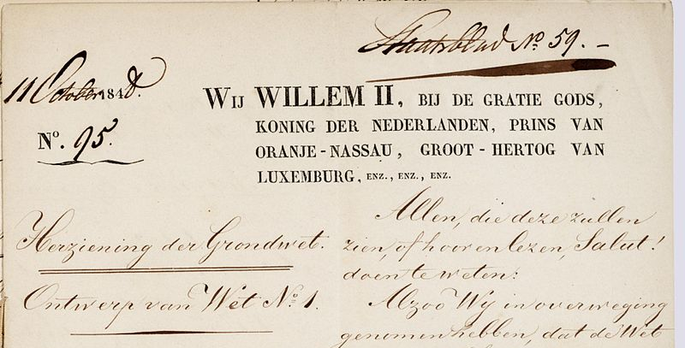
Dutch Constitution of 1848
Notes:
Source: https://nl.wikipedia.org/wiki/Grondwetsherziening_van_1848#/media/File:Grondwet_1848_Nl-HaNA_2.02.04_514_01.jpg

Slide 4
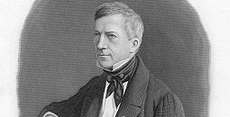
Anti-Revolutionaries
Notes:
Source: http://www.dbnl.org/auteurs/index.php?c=19&l=G

Slide 5
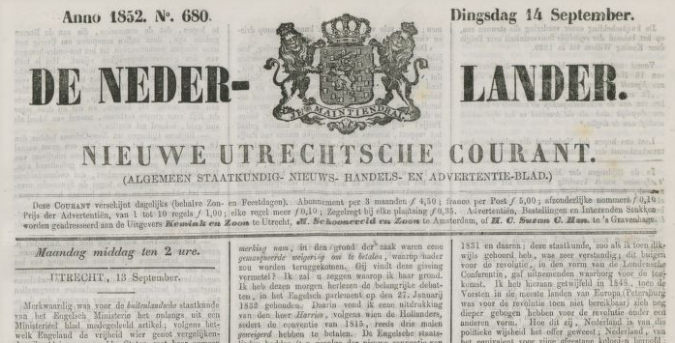
De Nederlander
Notes:
Source: http://www.theeuropeanlibrary.org/tel4/newspapers/issue/fullscreen/3000112843225
Circulation: 350 (21 aug. 1848-29 juni 1850 (nr. 1-nr. 572) en 1 juli 1850-30 juni 1855 (nr. 1-nr. 1539): See http://www.hdc.vu.nl/nl/Images/Nederlander,Nieuwe_Utrechtsche_Courant_tcm215-132417.pdf

Slide 6
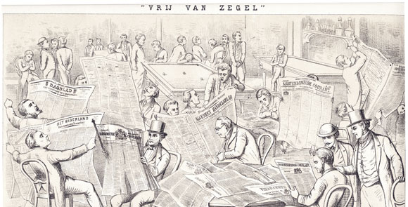
Abolition of the Stamp Tax
Notes:
Abolition of Dagbladzegel on 1 July 1869; Source: http://www.iisg.nl/exhibitions/censorship/pm3966.php

Slide 7
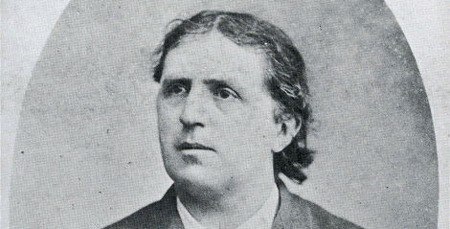
Abraham Kuyper
Notes:
Source: http://www.npogeschiedenis.nl/speeches/nederlandsespeeches/koninkrijk-der-nederlanden/Toespraak-Abraham-Kuyper-tijdens-het-Congres-van-kerkelijke-ambtdragers-en-gemeenteleden-.html

Slide 8
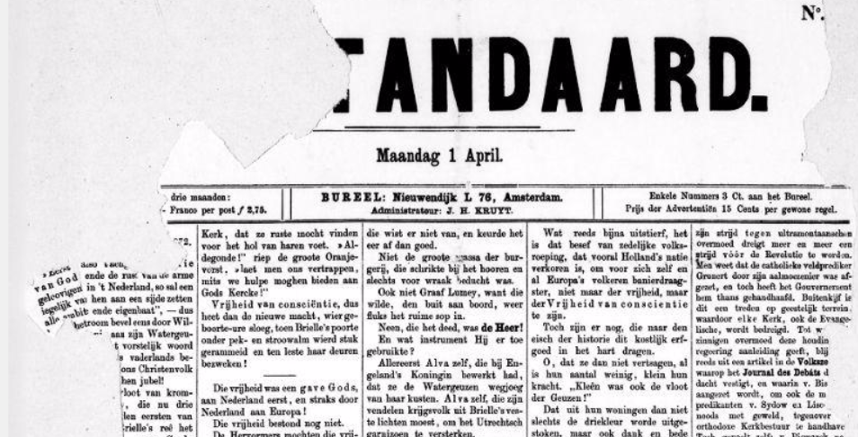
De Standaard
Notes:
Source: http://www.delpher.nl/nl/kranten/view?coll=ddd&cql%5B%5D=%28date+_gte_+%2201-04-1872%22%29&cql%5B%5D=%28date+_lte_+%2205-04-1872%22%29&cql%5B%5D=ppn+any+%28832667536%29&resultscoll=dddtitel&identifier=ddd%3A011065219%3Ampeg21%3Ap001

Slide 9
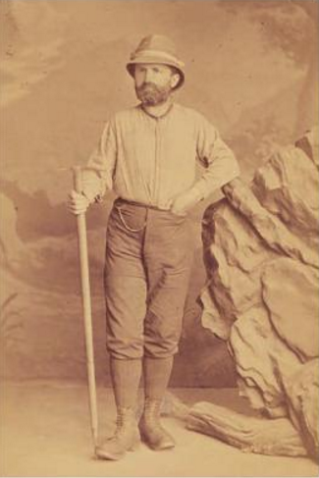
Nervous Collapse
Notes:
February 1876 - April 1877
Source: https://books.google.com/books?id=XUSWAgAAQBAJ&lpg=PA108&ots=aZTM8l2DW4&pg=PA105#v=onepage&q&f=false

Slide 10
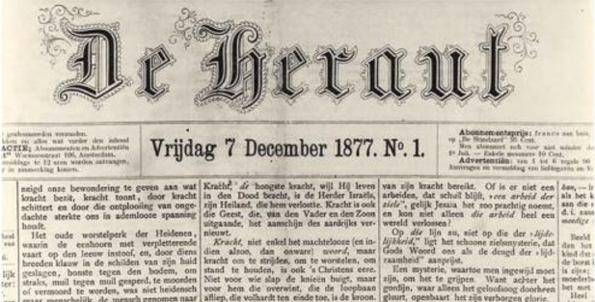
De Heraut
Notes:
Source: https://books.google.com/books?id=XUSWAgAAQBAJ&lpg=PA108&ots=aZTM8l2DW4&dq=kuyper%20heraut%201878&pg=PA108#v=onepage&q=kuyper%20heraut%201878&f=false

Slide 11
Financial Data
Kuyper as Publisher

Slide 12
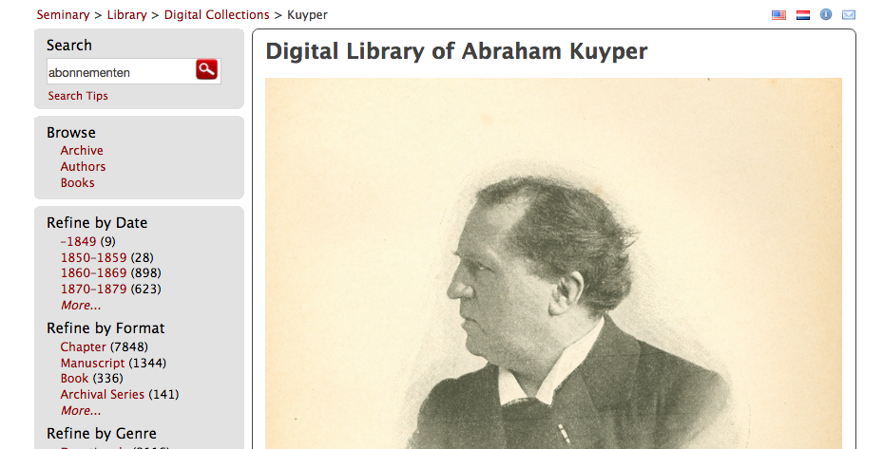
Digital Library of Abraham Kuyper
Notes:
Source: http://kuyper.ptsem.edu/

Slide 13
Research Cycle
Digitization
Encoding
Analysis
Visualization
Aggregation

Slide 14
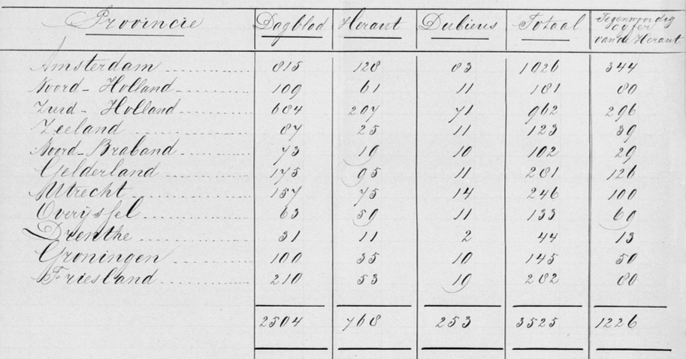
Subscribers (1871)
Notes:
Source: http://kuyper.ptsem.edu/id/Kuyper185-192/dmd019

Slide 15
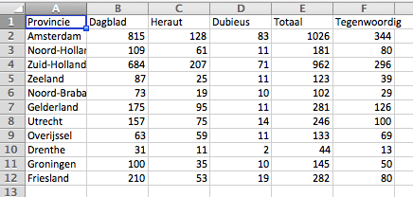
Encoding

Slide 16
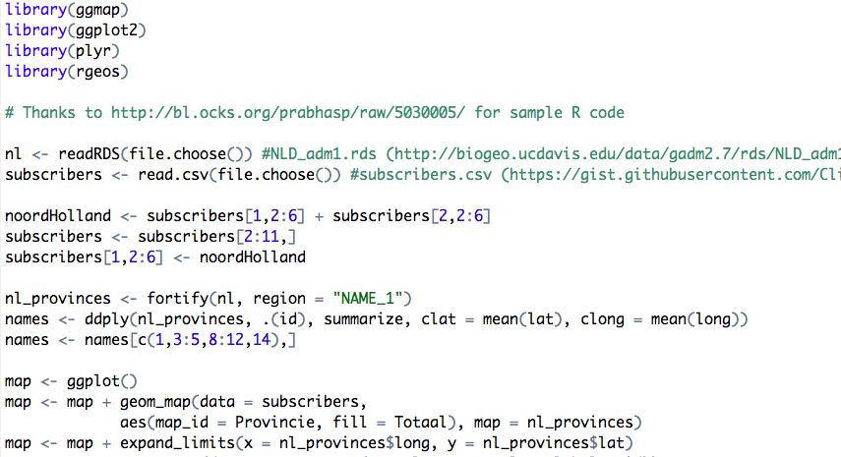
Analysis

Slide 17
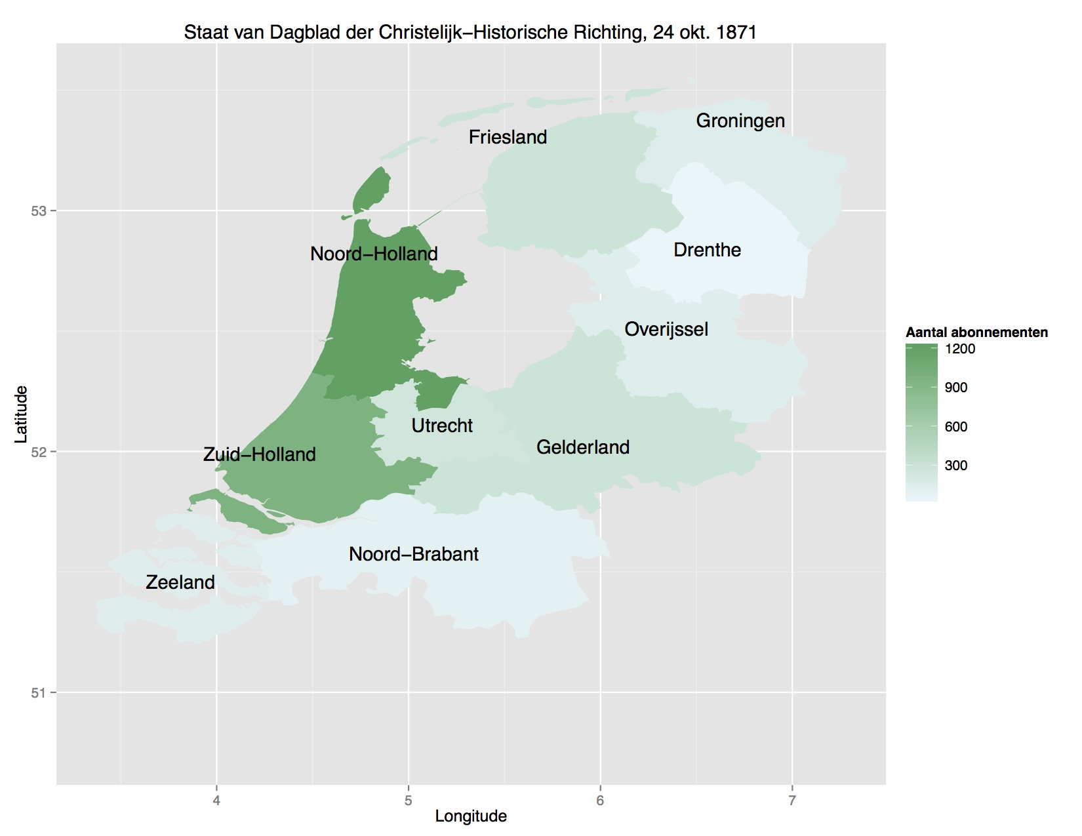
Visualization

Slide 18
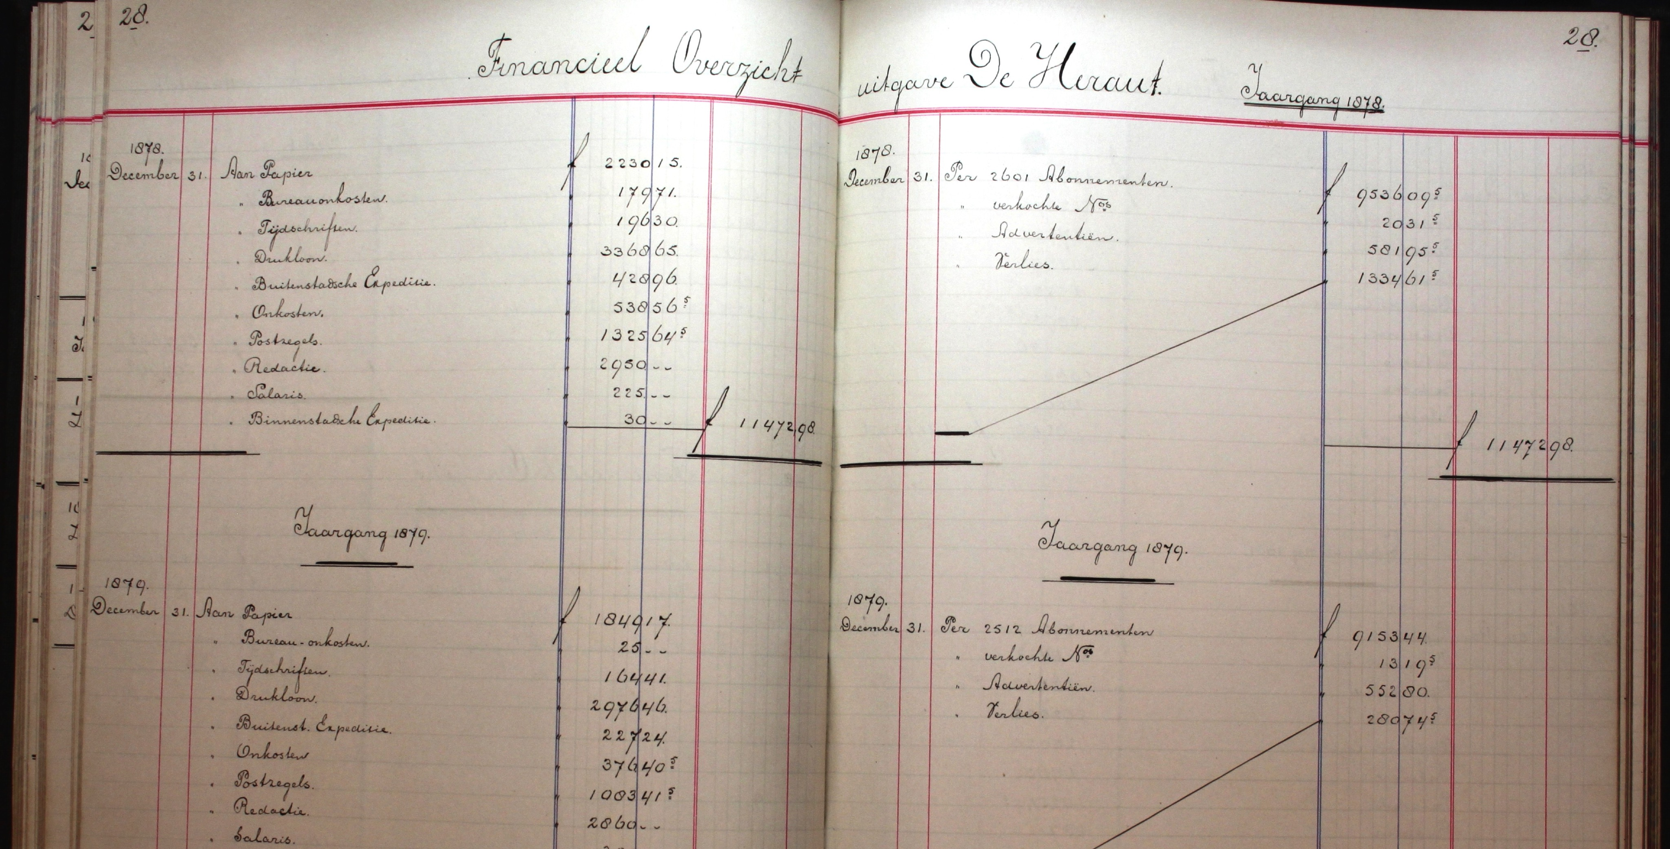
Ledgers of De Heraut
Notes:
Source: Historical Documentation Centre for the History of Dutch Protestantism, Vrije Universiteit Amsterdam

Slide 19
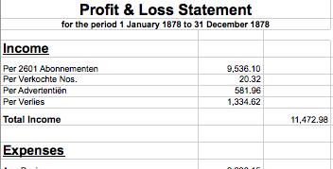
Encoding

Slide 20

Encoding
Notes:
Source: https://en.wikipedia.org/wiki/XBRL#/media/File:XBRL.svg

Slide 21
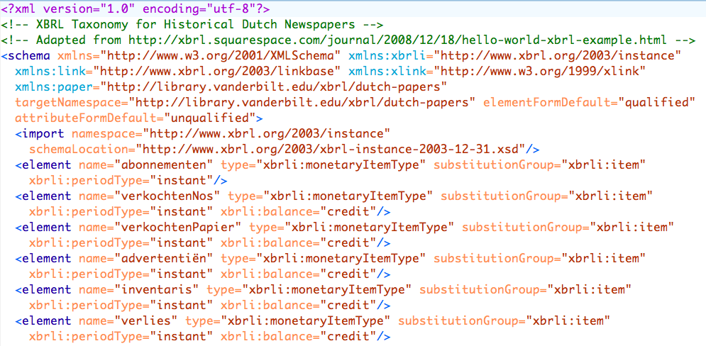
XBRL Taxonomy

Slide 22
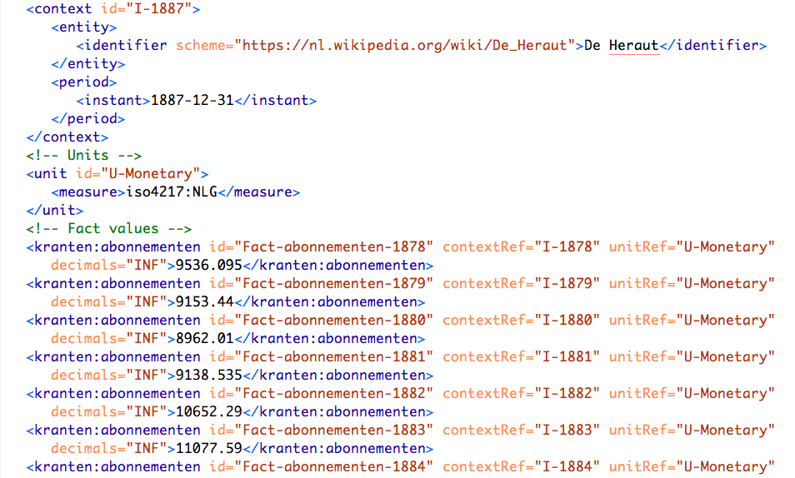
XBRL Instance

Slide 23
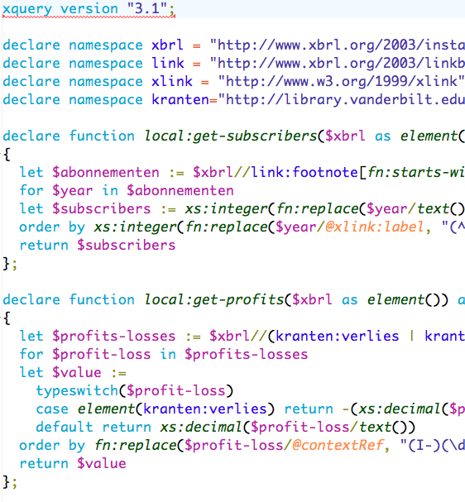
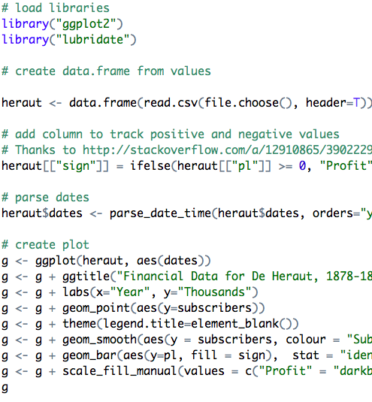
Analysis

Slide 24
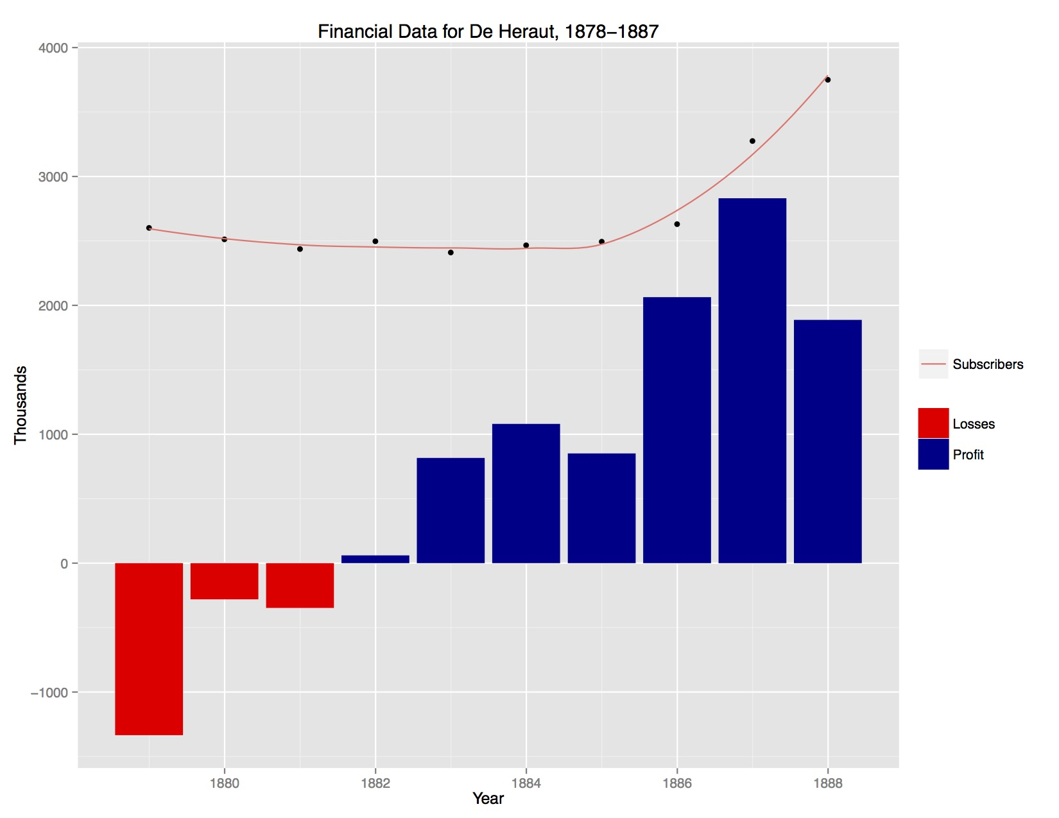
Visualization

Slide 25
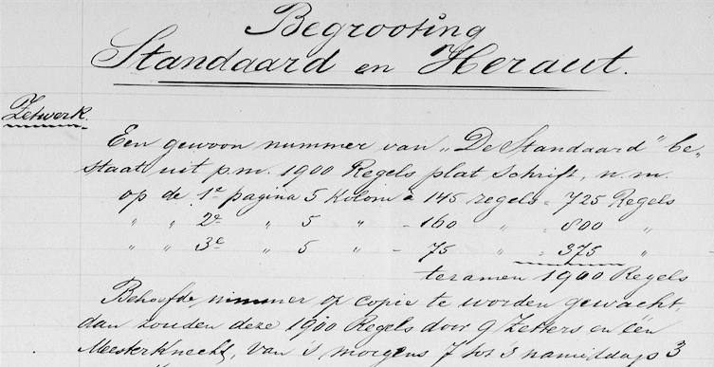
Budget Estimate (1897)
Notes:
Source: http://kuyper.ptsem.edu/id/Kuyper185-192/dmd038

Slide 26
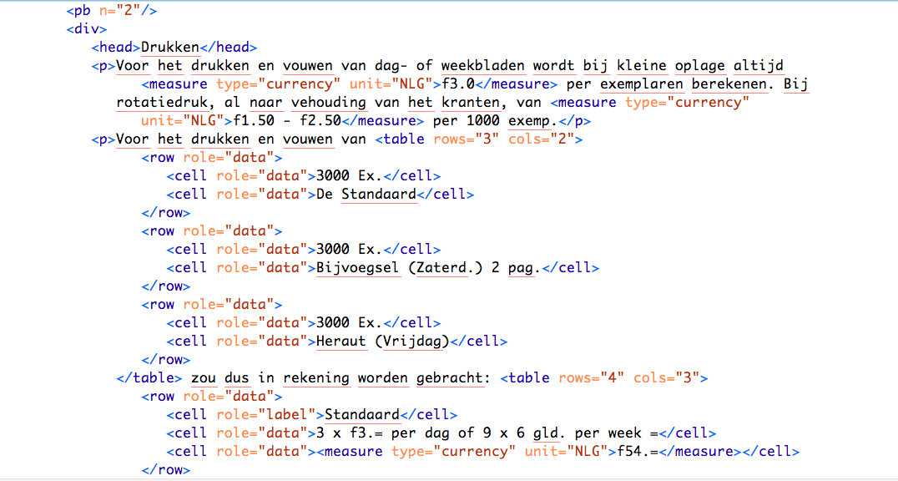
TEI Transcription

Slide 27
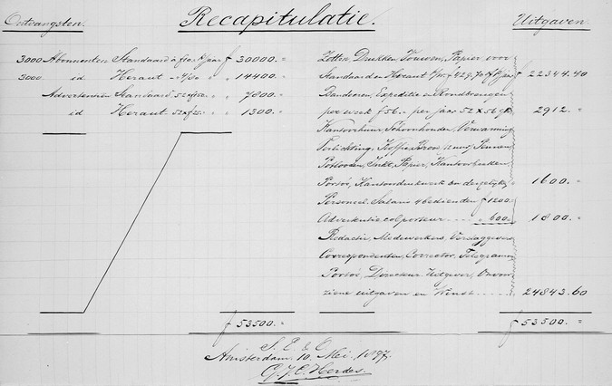
Recapitulation

Slide 28
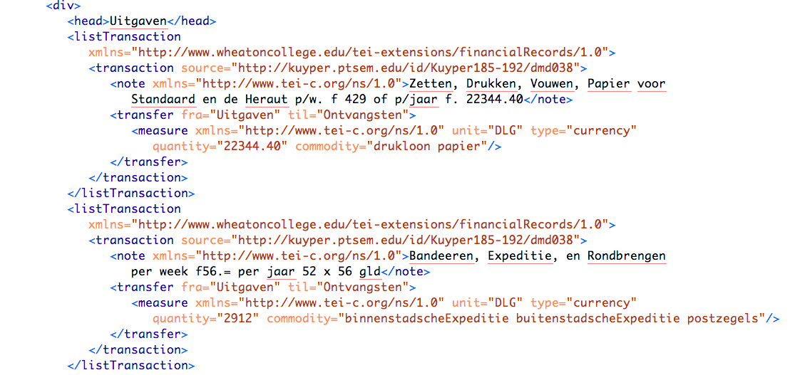
Transactionography

Slide 29
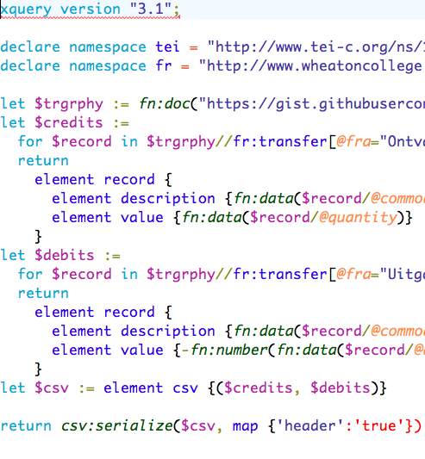
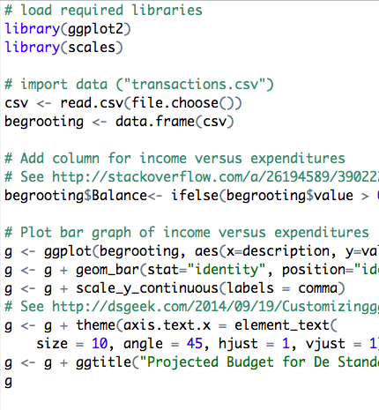
Data Extraction & Analysis

Slide 30
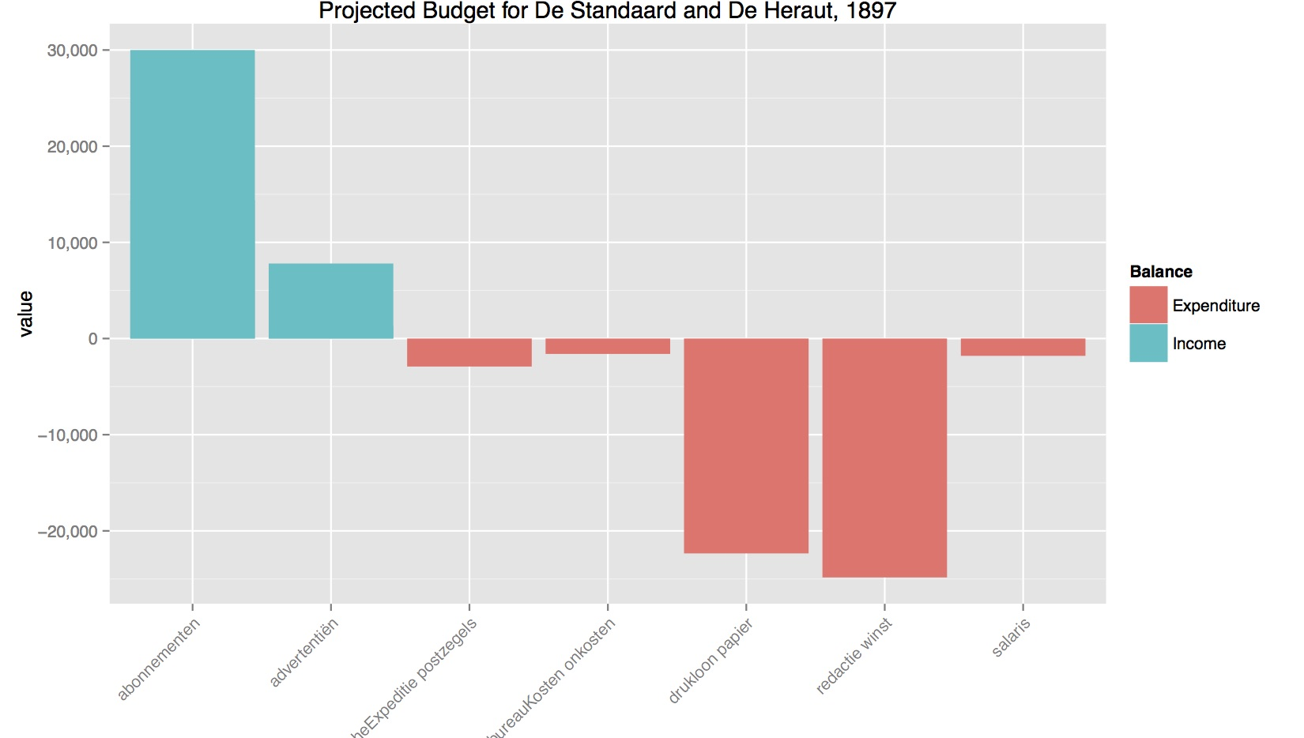
Visualization

Slide 31
Questions
How best to aggregate data from different sources?
What level of data loss is acceptable when encoding historical sources?
Could a shared XBRL taxonomy be developed for (kinds of) historical documents?

